Slide 1

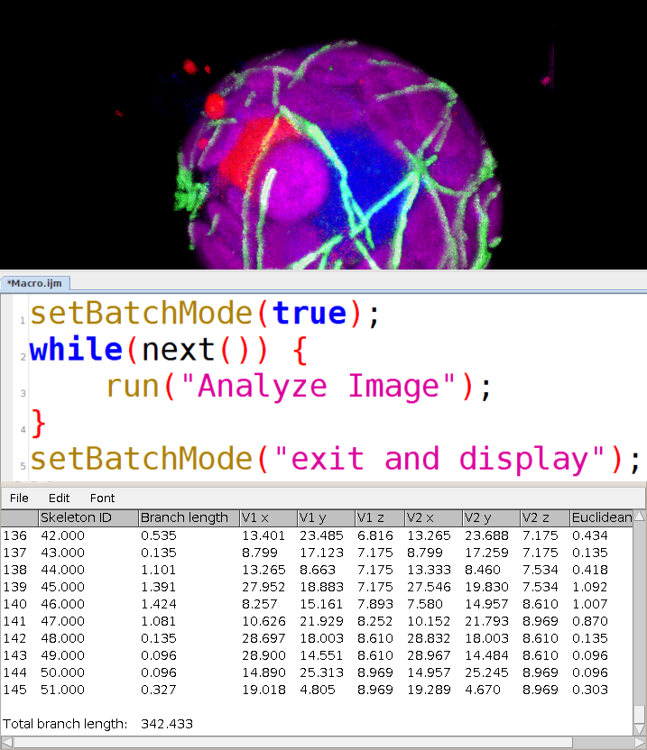






ImageJ Macro Programming
for Biological Image Analysis
05/2021
Leslie
Bancel-Vallee
Volker Baecker
volker.baecker@mri.cnrs.fr

Slide 2
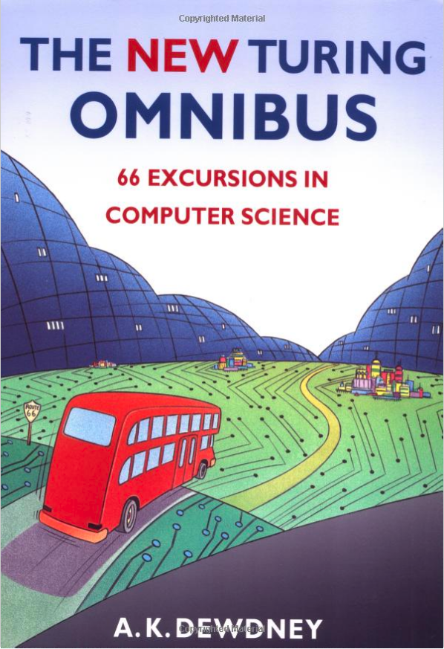
Programming and computer science are fun :)

Slide 3
Macros, Scripts and Plugins
Macro
  automatize
  ImageJ
  interpreted by ImageJ
  simple
  missing data structures
  limited reusability
  slow
Script
  general programming
  jvm or script interpreter
  complex
  datastructures available
  better reusability
  slow
Java Plugin
  general programming
  java virtual machine
  complex
  datastructures available
  good
  reusability
  fast

Slide 4
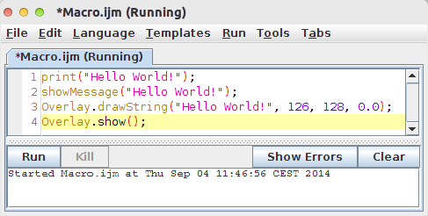
The FIJI Macro Editor
Plugins>New>Macro

Slide 5
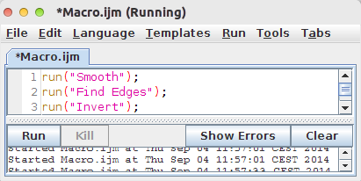
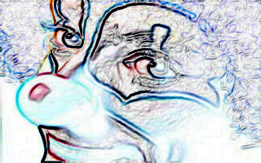
Recording Commands
You don't know how to use a command in a macro? - Just record it !
Open sample image File>Open Samples>Clown
Plugins>Macros>Record…
Run
  Process>Smooth
  Process>Find Edges
  Edit>Invert
Create the macro
Close the image
Open another sample image
Run the macro

Slide 6

Exercise 01.01-01.04

Slide 7
Basic Datatypes - Numbers
floating point
    special values
      NaN, Infinity, -Infinity
    operations
      - (unary), +, -, *, /, %
    bitwise operations
      ~, |, ^, &, <<, >>
    build in functions
      parseFloat, sin, cos, sqrt, pow, exp, log, floor, round, ...

Slide 8
Decimal, Binary, Hexadecimal

Slide 9
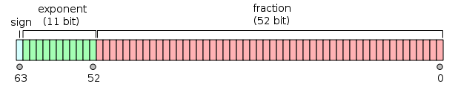
Floating Point
0.3 - 0.2 - 0.1;
(0.3 - 0.2 - 0.1 == 0);
(0.3 - 0.2 - 0.1 < 0.000000000001);

Slide 10
Exercise 02.01-02.03

Slide 11
Strings
literals in quotes or double-quotes
\ is escape character
\n newline
operations
  concatenation (+)
build in functions
  endsWith, indexOf, lastIndexOf, lengthOf, matches, replace, split, substring, toLowerCase

Slide 12
Strings and regular expressions
concatenation
  "Hello" + " World!" ;
  "2 + 2 = " + 2+2 ;
split, matches and replace work with regular expressions
[ ] set [aA] either a or A
- range [0-9] any digit
. any character [0-9]. a digit followed by one character
* zero or more .* any string
? zero or one [0-9] ? an optional digit
+ one or more [0-9]+ one or more digits
^ negation [^0-9] any character that is not a digit
&& and [0-9&&[^3]] a digit that is not 3
| or [0-9]|[a-zA-Z] a digit or a lower or upper case letter
() a group
replace("A01GFP_c001_t001_z001.tif",
"_t([0-9][0-9][0-9])", "_t0$1");

Slide 13
Exercise 03.01-03.04

Slide 14
Booleans
Comparison operations result in boolean
  ==, <, >, <=, >=, !=
Operations on booleans are
  not (!), and (&&), or(||)
example
  (x>0 && x<2048)
{and, or, not} functionally complete set of boolean operations
  xor:
"not";
(!false); 1
(!true); 0
"and";
(false && false); 0
(false && true); 0
(true && false); 0
(true && true); 1
"or"
(false || false); 0
(false || true); 1
(true || false); 1
(true || true); 1
((!a && b) || (a && !b))

Slide 15
Exercise 04.01-04.02

Slide 16
Variables
Variable
  has identifier and value
  must be defined by an assignment
  copied by value for basic types, by reference for arrays
  has a scope
  operations on variables
    ++, --, +=, -=, *=, /=
radius = 11.25;

Slide 17
Exercise 05.01-05.03

Slide 18
Array
indexed variable
  a[i]
  can be created literally or with a size
  elements can have different types
  elements can only be of basic types
  only one dimensional arrays
  a.length gives the number
  of elements in a
Array.concat
Array.copy
Array.fill
Array.findMaxima
Array.findMinima
Array.getStatistics
Array.print
Array.show,
...
options = newArray(34, true, "Huang");
print("threshold value:", options[0]);
print("dark background:", options[1]);
print("threshold method:", options[2]);

Slide 19
Exercise 06.01-06.03

Slide 20
if...then...else
conditional execution of code
  depending on input or state
if (condition) {
list of statements 1
} else {
list of statements 2
}

Slide 21
Exercise 07.01-07.02

Slide 22
loops
repeatedly exexute a code block
  a condition is evaluated for each iteration and decides when the loop finishes
three flavours
  for
    number of iterations known
  while
    condition before each iteration
  do while
    condition after each iteration

Slide 23
for
for (<initialization>; <condition>; <increment>) {
<list of statements>
}
init
cond
statements
increment

Slide 24
Exercise 08.01-08.04

Slide 25
while
while (<condition>) {
<list of statements>
}
cond
statements

Slide 26
Exercise 09.01-09.02

Slide 27
do-while
do {
<list of statements>
} while (<condition>);
statements
cond

Slide 28
Exercise 10.01

Slide 29
user defined functions
function <name_of_the_function>(<list of args>) {
<list of statements>
}
function max(x,y) {
if (x>y) return x;
else return y;
}
r = max(19, 42);
print(r);

Slide 30
Variable scope and global variables
functions
  have their own variable scope
  can communicate via global variables
a = "outer";
show();
print(a);
function show() {
a = "inner";
print(a);
}
inner
outer
var a = "outer";
show();
print(a);
function show() {
a = "inner";
print(a);
}
inner
inner

Slide 31
recursion
f(0) = 1
f(n) = n * f(n-1)
f(5)
5 * f(4)
5 * 4 * f(3)
5 * 4 * 3 * f(2)
5 * 4 * 3 * 2 * f(1)
5 * 4 * 3 * 2 * 1 * f(0)
5 * 4 * 3 * 2 * 1 * 1
5 * 4 * 3 * 2 * 1
5 * 4 * 3 * 2
5 * 4 * 6
5 * 24
120
functions
  can call themselves
  can call each other mutually
  termination condition needed
useful for
  compact programs
  traversing recursive structures (for example trees)

Slide 32
Exercise 11.01-11.04

Slide 33
Macros as plugins
save macro with underscore in the name in plugins folder
run it from the menu or
create shortcut via
  Plugins>Shortcuts>Create Shortcut...

Slide 34
Defining macros
macro sets
  multiple macros in one file
  assign a shortcut for each macro
macro "<name> [<short-cut>]" {
<list of commands>
}

Slide 35
Exercise 12.01-12.02

Slide 36
Part II
Background correction on a stack
Batch Merge channels
Batch Measure cells
Separate touching objects
Sort rois and measurements
Show rois of selected measurements
(Link the results table to the image)

Slide 37
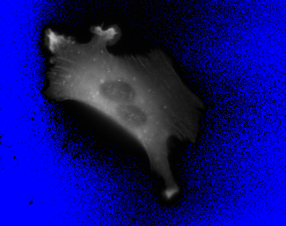
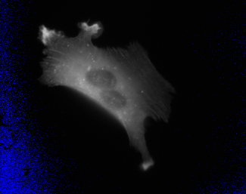
Background correction on a stack
the user selects a background region
the macro
  iterates over the series
    measures the mean intensity
    removes the region
    subtracts the value from the image
    restores the region
  useful commands
    nSlices - the number of slilces in the stack
    setSlice(i) - set the current slice
    getStatistics(area, mean);
    run("Select None");
    run("Restore Selection");
    run("Subtract...", "value=5 slice");
actine-stack.tif

Slide 38
Exercise 13

Slide 39
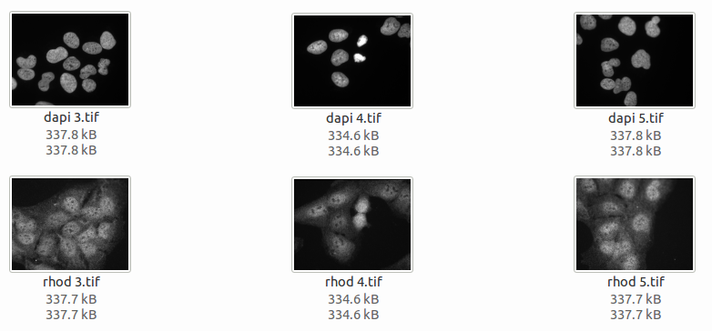
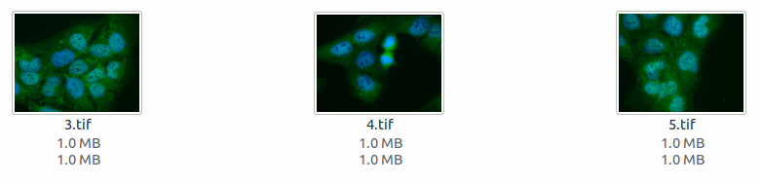
Merge channels of all Images in a folder

Slide 40
Exercise 14.01-14.05

Slide 41
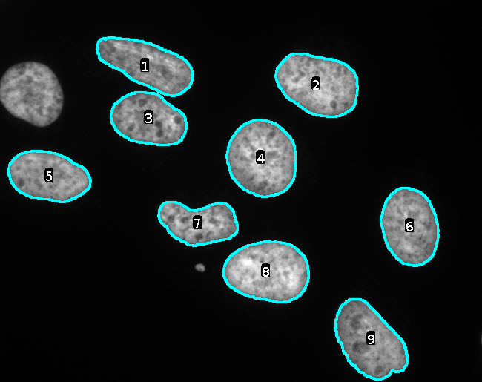
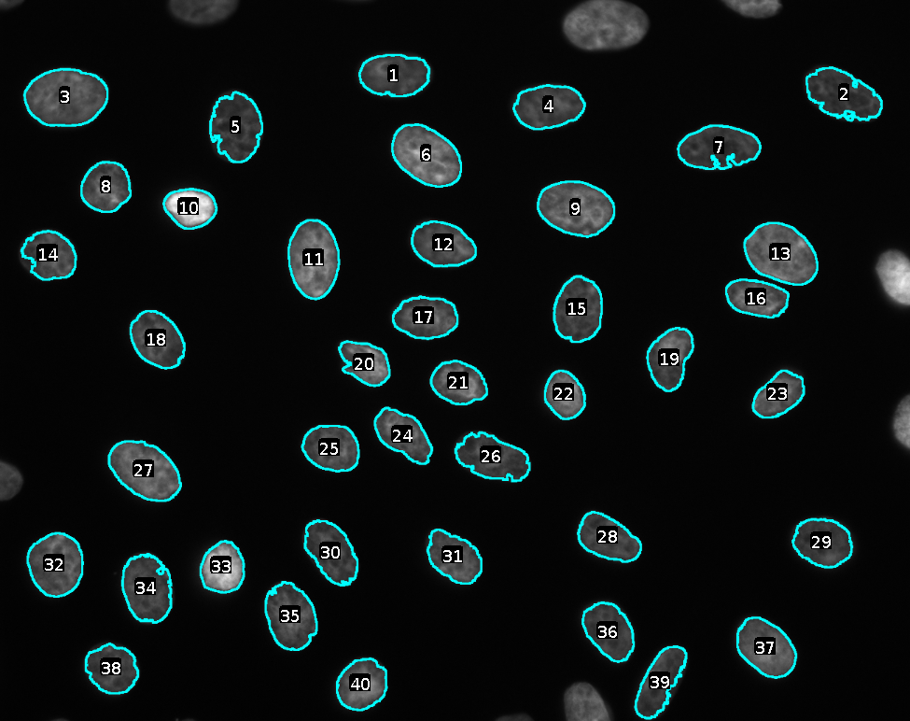
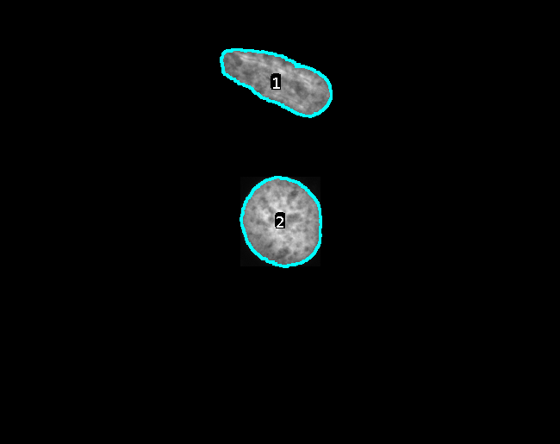
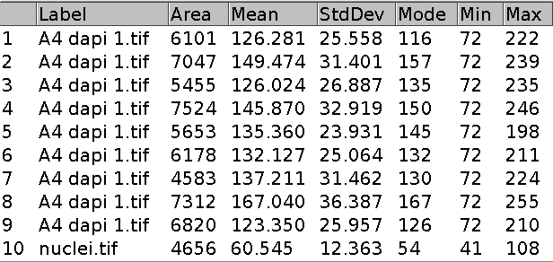
Batch - measure cells

Slide 42
Exercise 15

Slide 43
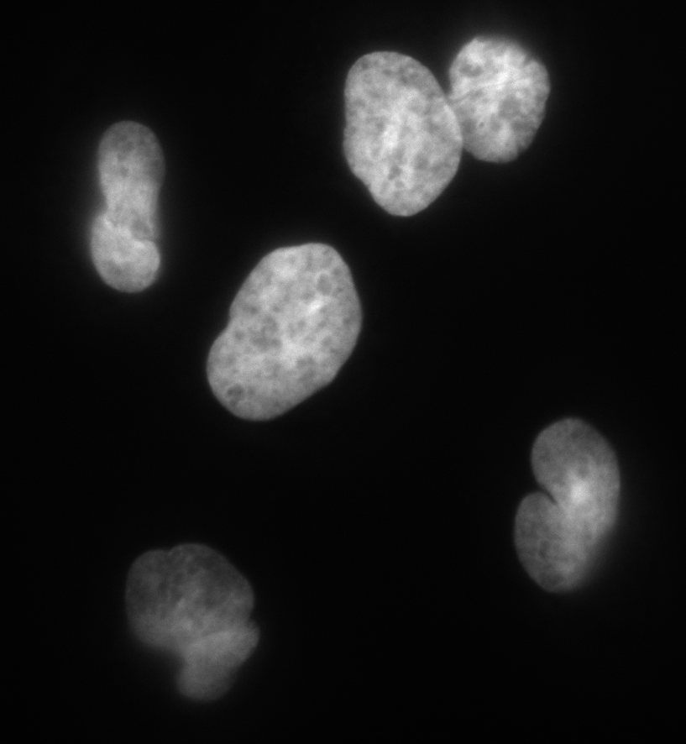
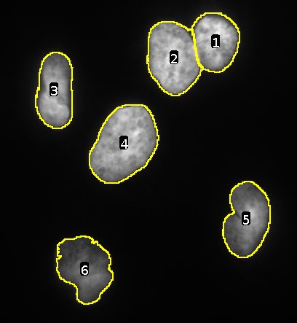
Separate touching objects using a watershed

Slide 44
Exercise 16

Slide 45
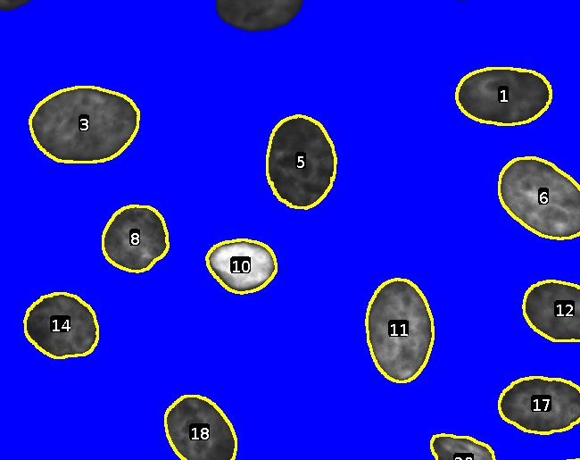
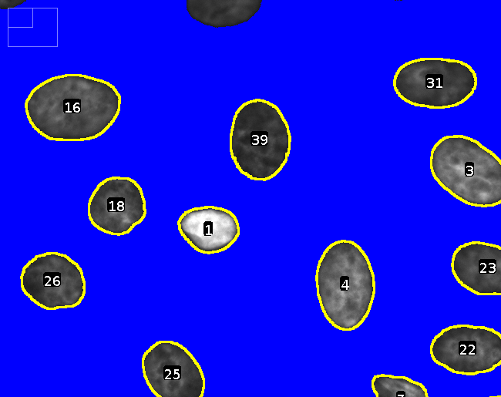
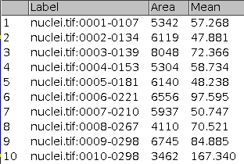
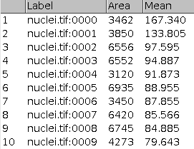
Sort rois and measurements by a column

Slide 46
Exercise 17

Slide 47
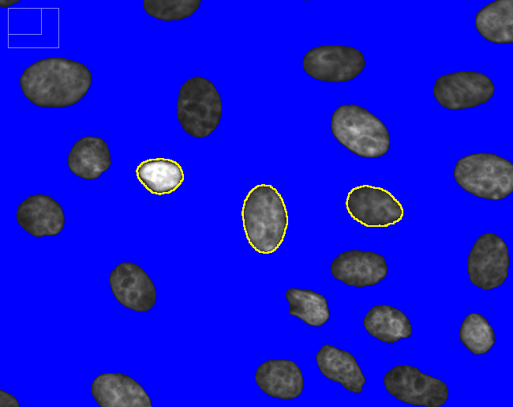
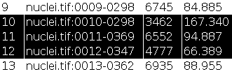
Show rois of selected measurements

Slide 48
Exercise 18

Slide 49
The End
while(questions) {
ask();
}
print("Thank you!");
init
cond
statements
increment

Slide 50
Bibliography
[1] Wikimedia. File:IEEE 754 Double Floating Point Format.svg.
[2] ASA standard x3.4-1963. Technical report, June 1963.
[3] IEEE 754-2008. Technical report, August 2008.
[4] Michael R. Berthold, Nicolas Cebron, Fabian Dill, Thomas R. Gabriel, To-
bias Ktter, Thorsten Meinl, Peter Ohl, Kilian Thiel, and Bernd Wiswedel.
KNIME - the konstanz information miner: version 2.0 and beyond. ACM
SIGKDD Explorations Newsletter, 11(1):26, November 2009.
[5] Michael R. Lamprecht, David M. Sabatini, and Anne E. Carpenter. Cell-
Profiler: free, versatile software for automated biological image analysis.
BioTechniques, 42(1):71–75, January 2007.
[6] Jérôme Mutterer. Programming with the ImageJ macro language. In Im-
ageJ User and Developer Conference 2010, Luxembourg, 2010. Centre de
Recherche Public Henri Tudor.

Slide 51
Bibliography
[7] Seymour Papert. Mindstorms: children, computers, and powerful ideas.
Basic Books, New York, 2nd ed edition, 1993.
[8] Johannes Schindelin, Ignacio Arganda-Carreras, Erwin Frise, Verena
Kaynig, Mark Longair, Tobias Pietzsch, Stephan Preibisch, Curtis Rue-
den, Stephan Saalfeld, Benjamin Schmid, Jean-Yves Tinevez, Daniel James
White, Volker Hartenstein, Kevin Eliceiri, Pavel Tomancak, and Albert
Cardona. Fiji: an open-source platform for biological-image analysis. Na-
ture Methods, 9(7):676–682, June 2012.
[9] Caroline A Schneider, Wayne S Rasband, and Kevin W Eliceiri. NIH image
to ImageJ: 25 years of image analysis. Nature methods, 9(7):671–675, July
2012. PMID: 22930834.
[10] Kenneth Slonneger. Formal syntax and semantics of programming lan-
guages: a laboratory based approach. Addison-Wesley Pub. Co, Reading,
Mass, 1995.
[11] Wikipedia. Double-precision floating-point format — wikipedia, the free
encyclopedia, 2014. [Online; accessed 28-July-2014].
[12] Wikipedia. Ieee 754-1985 — wikipedia, the free encyclopedia, 2014. [Online; accessed 28-July-2014].

